Slide 1
Data@ANZ
Predictive Analytics
Akash Kumar Jha
8093akash@gmail,com

Slide 2
Data Preprocessing
After loading the data calculated the mean salary for each customer, then calculated the annual salary for each customer.
Plotted scatterplots to observe correlation between our target variable i.e. “Annual Salary” and other independent features.

Slide 3
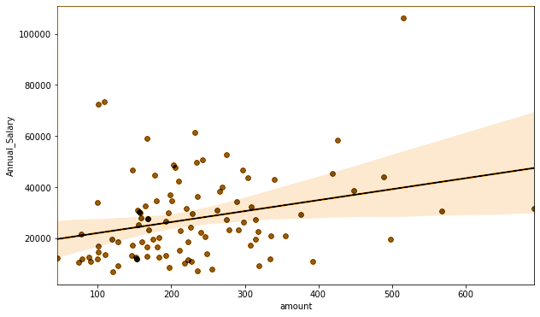
Data Preprocessing
Customer ‘balance’ and ‘amount’ showed a positive correlation, while the correlation between ‘age’ and ‘annual salary’ shows a slight negative correlation.

Slide 4
Data Preprocessing
Created a extra new feature for our model, i.e. average payment made by the customer.
For predicting the annual salary used “age”,”balance”,”payment” as independent features.
Separated train and test data for model building

Slide 5
Model Building
For linear model the adjusted R^2 shows that it only explains about 2% of variation in customers annual salary. Using this model to predict annual salary would be risky.
For the decision tree model, RMSE is almost close to 20000, which indicates the inaccuracy of the model.
While both model performed poorly, sample prediction gave us realistic values for annual salary.

Slide 6
Thank You!! Any Questions?

